Slide 1

Officiating Pickleball
2023
Day 3
© 2023 USA Pickleball

Slide 2
General Course Outline – Day 3
(Section References correspond the USAP Officiating Handbook)
Day 3:
Follow-up from Day 2 (slides 188 - 198
Section 5: Key Situations and Rules Violations (slides 198 – 211)
Section 6: Player Behavior and Remedies (slides 212 – 245)
Section 7: Dual Referee Option and New Sanctioning Formats (slides 246 – 250)
Section 8: Medal Matches with Line Judges (slides 251 – 271)
End of Day 3 – Conclusion, Next Steps & Questions (slides 272 – 277)

Slide 3
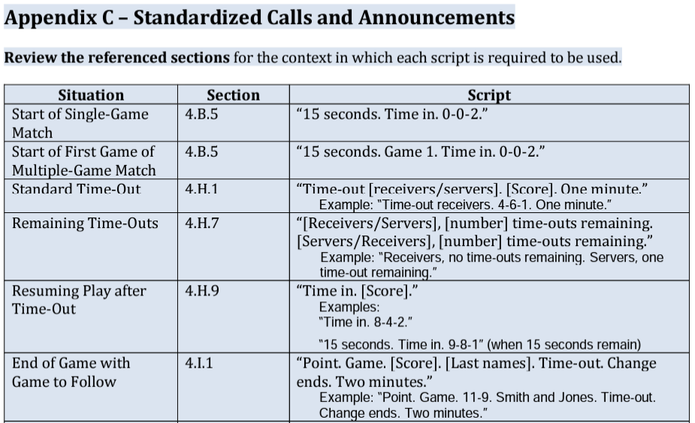
Updates from Day 2

Slide 4
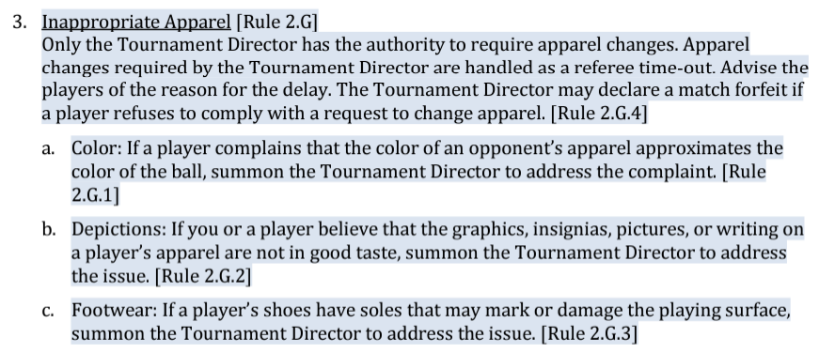
Updates from Day 2

Slide 5
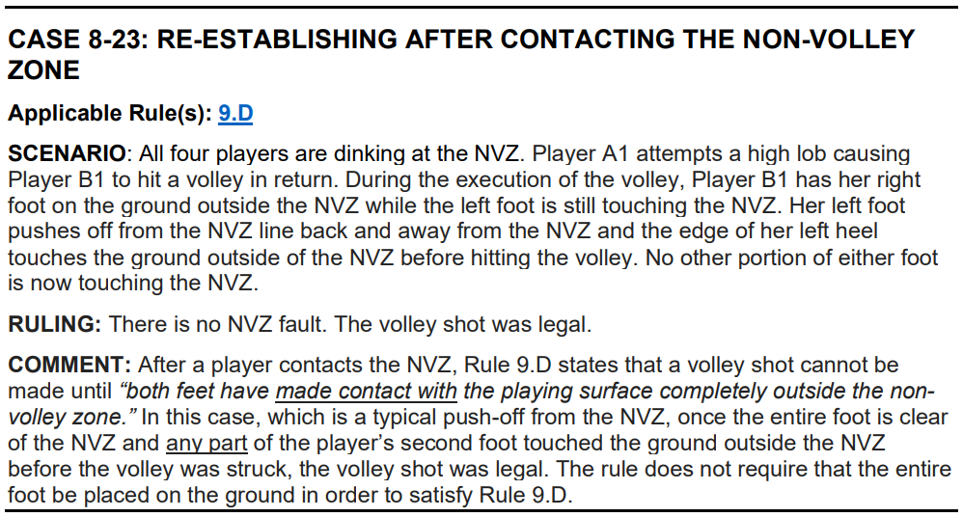
Updates from Day 2

Slide 6
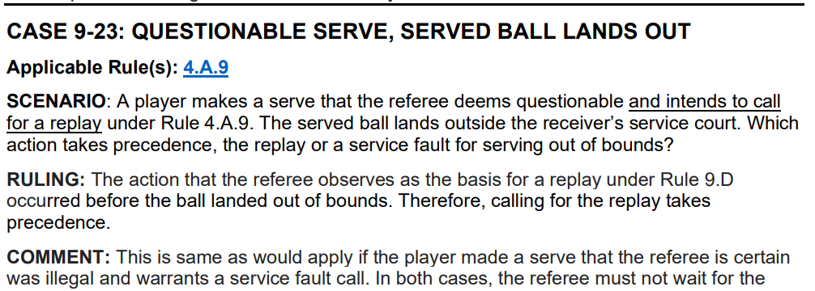
Updates from Day 2

Slide 7
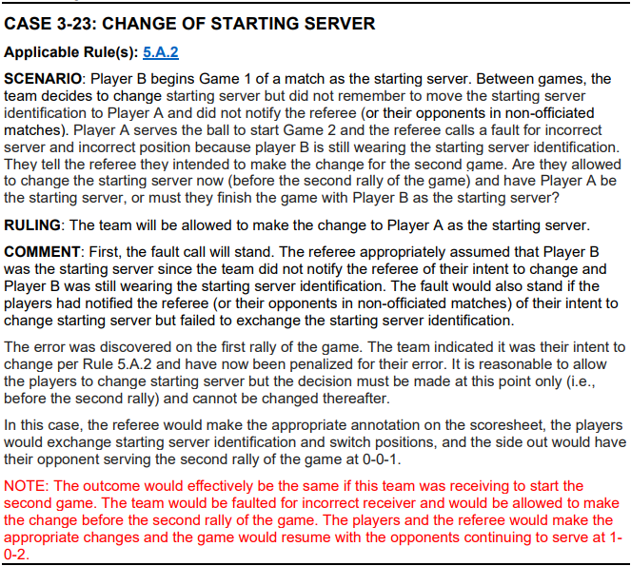
Updates from Day 2

Slide 8
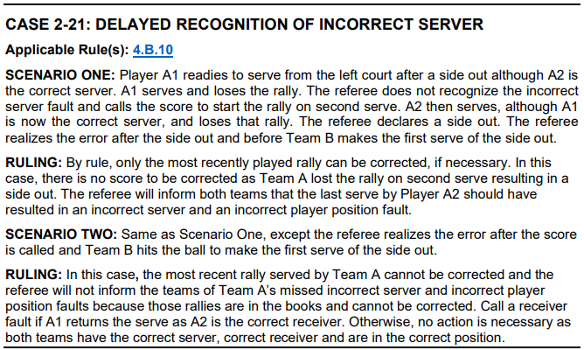
Updates from Day 2

Slide 9
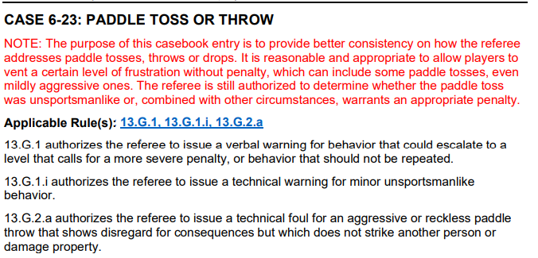
Updates from Day 2

Slide 10
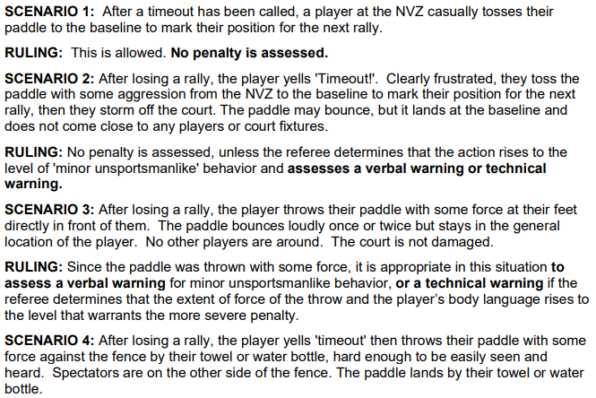
Updates from Day 2

Slide 11
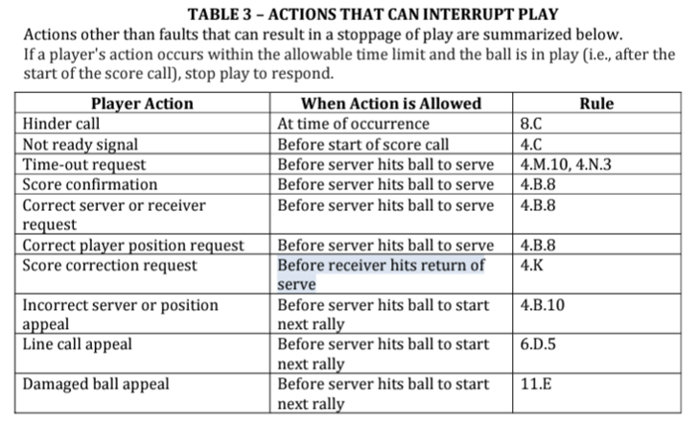
Stopping Play

Slide 12
Questioned Calls/Rulings
Call Players To Net To Discuss
Ignore Spectator Input
Consult Line Judges, when in use
When Requested or Necessary to Resolve Dispute, Summon Head Referee or TD

Slide 13
Questioned Calls/Rulings (cont’d)
If Head Referee or Tournament Director is called:
If Referee’s Ruling is Correct – for the Disputing Team:
- Charge a Standard Time-Out Against Player/Team
- Issue a Technical Warning (TW) Against Player/Team
- If no standard Time-Outs remain, a Technical Foul (TF)
will be assessed
If Referee’s Ruling is incorrect – call “Correction” and replay the point.

Slide 14
Balls- Broken, Cracked, Degraded or Soft/Paddle
Broken/Cracked Ball:
Play continues to completion of rally
Referee determines if ball affected outcome
Replay possible at referee’s discretion only
Fault if player stops play
Degraded/Soft Ball:
Play continues to completion of rally
Fault if player stops play
If all players agree that the ball is degraded or soft, the ball will
be replaced – NO replay of the prior rally

Slide 15
Appealed Line Calls
Players are NOT required to make a line call before appealing to the
referee to make the call (Rule 6.D.3)
ONLY when appealed, make the call If you had a good angle & without a doubt clearly saw the ball “In” or “Out“.
Note: Exception when a Line Judge’s view was blocked you may make the call
immediately and without an appeal.
If you clearly saw it, say, “The ball was in/out” and avoid using, “I think the ball was
in/out”.
If you didn’t clearly see it, say “By rule, the call stands”.
Do Not overrule a line call unless you are absolutely certain the player’s call was incorrect

Slide 16
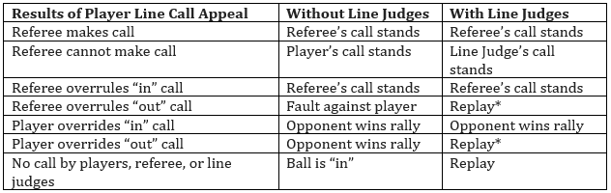
LINE CALL APPEAL ACTIONS
*Note: An officiating error occurs when an official’s or player’s “out” call is overruled or overridden,
resulting in the opponent being given an opportunity to replay the rally.

Slide 17
Questions on the Called Score
Before the ball is served, all questions are to be answered. Stop play by stepping forward and raising hand, verify score and then recall the score.
After the serve is made and before the return of serve:
Any player may stop play to correct the score.
Play continues to the end of the rally
Any correction is made before the next serve
Player comments about the score during the rally should be ignored.
A player who stops play to question the score has committed a fault and loses the rally.

Slide 18
Questions on the Called Score (cont’d)
Answering Player Questions After the Score is Called, but BEFORE the Ball is Served (Struck) – Raise hand and step into the court and say:
“I will recall the score.”
LOOK at your scoresheet BEFORE answering the question!
After answering all questions, re-check player readiness (pause)
(Re-Call the score.) “ __ - __ - __.”
(Note: do not say “I will recall the score” twice!)

Slide 19
Questions on the Called Score (cont’d)
After the ball is served and after the return of serve:
- Play continues to the end of the rally.
- Any correction is made before the next serve.
- Player comments about the score during the rally should be ignored.
- A player who stops play to question the score has
committed a fault and loses the rally.

Slide 20
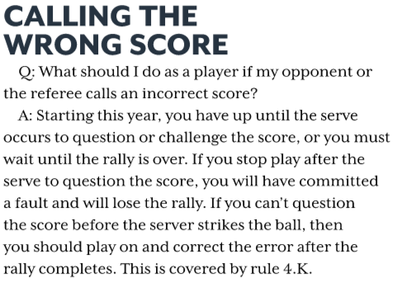
Calling the Wrong Score Jan/Feb 2022 Pickleball Magazine

Slide 21
Spectators & Coaching
Control spectators politely, yet firmly
Coaching permitted only during time-outs & between games
Coaching includes verbal, non-verbal and electronic
Do Not Allow Spectators To Coach, Make Line Calls Or Interfere With The Match In Any Way

Slide 22
Spectators & Coaching
Examples of Coaching
- “Get to the line”
- “Call time-out”
- “Hit to his backhand”
- “Down the middle”
- “Take your time”
- “Play the soft game”
Examples of comments that aren’t actionable and do not constitute coaching
- “Great shot”
- “Keep it going”
- “You can do this”
- “Come on”

Slide 23
Wrong Score Called Scenarios – Homework
Rulebook 4.K – 2022 Rulebook Change Document – 6. Rule 4.K
2021: If the server or referee calls the wrong score, any player may stop play before the “third shot” occurs to ask for a correction.
2022: If the server or referee calls the wrong score, once the serve is made, play shall continue to the end of the rally and the correction
made before the next serve. After the serve is made, a player who stops play based solely on an incorrect score call, will have
committed a fault and shall lose the rally.
Premises:
No one (player or ref) can stop play after the serve based solely on an incorrectly called score
A player may stop play after the serve to call a Player out of Position, either real, or based on an incorrectly called score.
After the rally, referee errors are corrected.
Scenario 1:
The correct score is 4-2-2.
Referee calls 4-2-1.
The serve is made.
Action 1: Receiver stops play and identifies the incorrectly called score. Result 1: a. Fault on the receiver. Point to the server.
b. Referee correction. Replay the rally.
Action 2: The rally completes, with the receivers winning the rally. The receivers point out the incorrectly called score. Result 2: a. The referee admits the error. Replay the rally.
b. The referee admits the error. The rally stands and results in a Side Out.

Slide 24
Wrong Score Called Scenarios – Homework
Rulebook 4.K – 2022 Rulebook Change Document – 6. Rule 4.K
Scenario 2:
The correct score is 14-10-2.
All players are positioned correctly based on the correct score.
Referee calls 13-10-2.
The serve is made.
Action 1: The receiver stops play, claiming that the server is out of position. Result 1: a. Fault on server being out of position.
b. Referee correction. Replay the rally.
Action 2: The receiver stops play and challenges the score. Result 2: a. Fault on the server being out of position.
b. Fault on the receiver. Point, game, match.
Action 3: The rally ends with the serving team winning the rally. The receiver identifies that server served
from the wrong position based on the called score. Result 3: a. Fault on server being out of position. Side out.
b. Referee recognizes that based on the incorrect score call, there is a player out of position, but also
realizes that the server was in fact in the correct position. The rally stands. Point, game, match.

Slide 25
Player Behavior and Remedies
Remain calm; maintain an open mind & benign demeanor
Meet player(s) mid-court, away from spectators
Issue verbal warning, technical warning or technical foul (Based On Severity)
If player(s) continues to create problems… escalate discipline, as required.

Slide 26
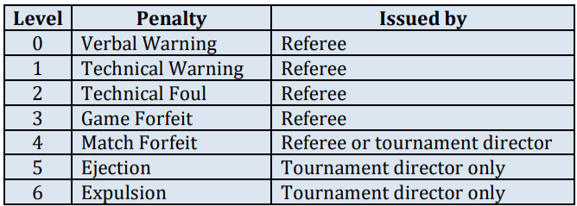
Player Behavior and Remedies
Warnings and fouls may be called from the time the players arrive at the court for a match until the completion of the match.

Slide 27
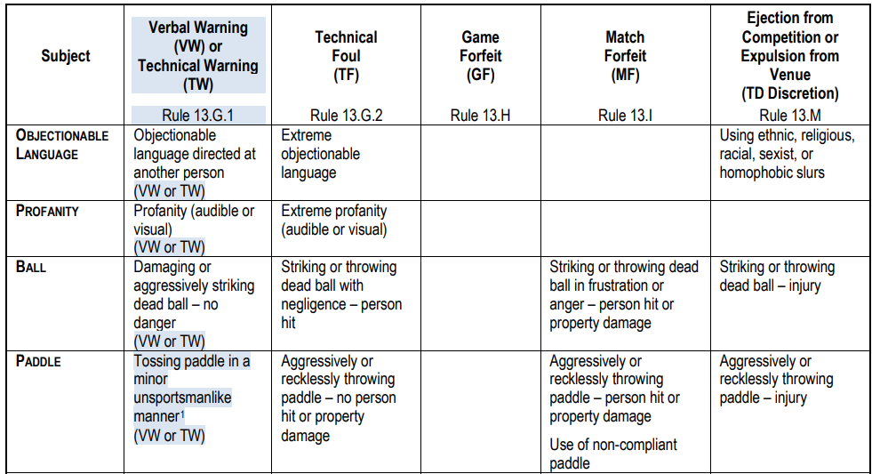
Progressive Disciplinary Action – Appendix B

Slide 28
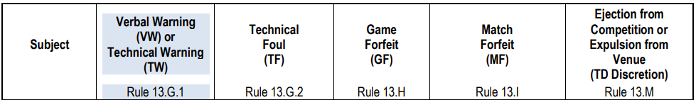
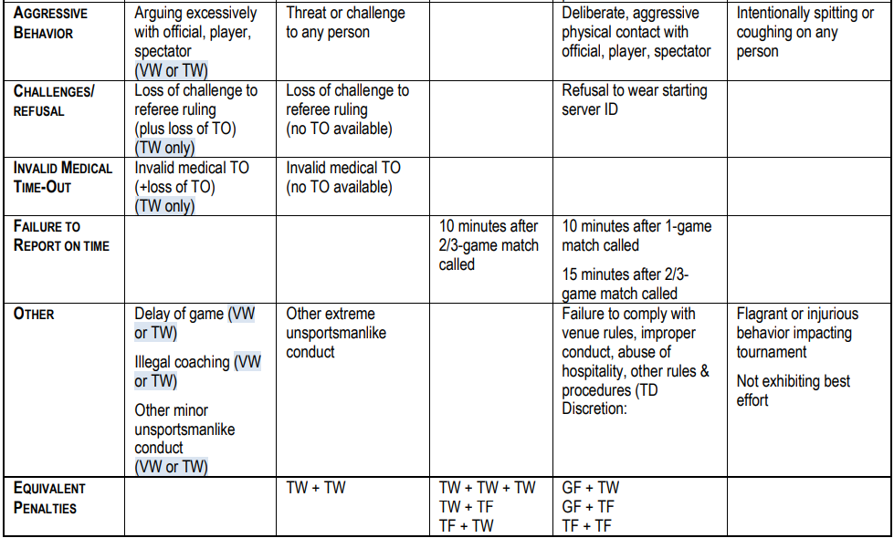
Progressive Disciplinary Action – Appendix B

Slide 29
Verbal Warnings
A Verbal Warning (VW) is issued to prevent any inappropriate behavior from escalating
One verbal warning may be issued to each team during a match.
If the behavior is severe enough, a technical warning (TW) or Technical Foul may be issued prior to a verbal warning.
Once a Technical Warning (TW) or Technical Foul (TF) has been issued to a team, a verbal warning to that team is no longer available.
A verbal warning typically precedes a technical warning (TW)
A verbal warning does not result in any penalty.
Note VW on the front of the scoresheet and annotate on the back of the scoresheet (similar as for a TW or TF)

Slide 30
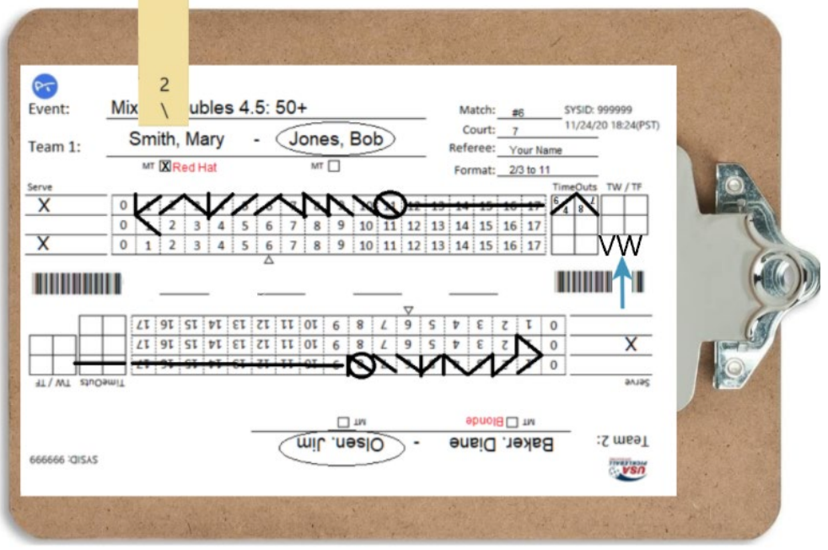
Recording Verbal Warnings

Slide 31
Technical Warnings
Technical warnings (TW) are to be assessed after the rally is over.
A technical warning (TW) typically precedes a technical foul (TF)
A second technical warning in a match (by either partner for any reason) warrants a TF TW+TW = TF
1 + 1 = 2 Strikes

Slide 32
Technical Warnings (cont’d)
After technical warning is issued, on the scoresheet:
Place a “TW” in the TW/TF box next to the T/O boxes.
Record details on back of scoresheet
(Do Not Remove Server Clip)

Slide 33
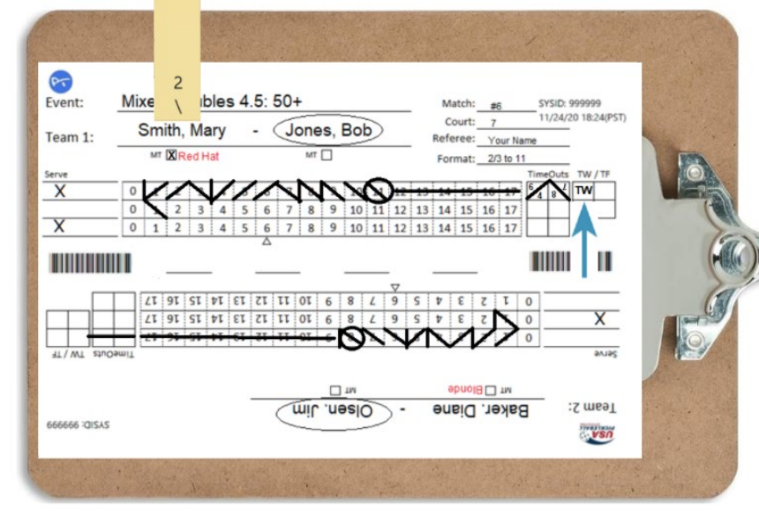
Recording Technical Warnings

Slide 34
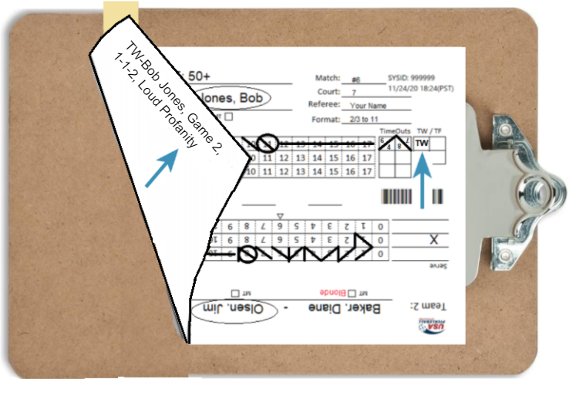
Recording Technical Warnings

Slide 35
Technical Warnings (cont’d)
After Documenting TW:
Announce “15 Seconds”
Check Line Judge Readiness, if used
After 15 Seconds, Call “Time in”
Call Score & Begin 10-Second Count

Slide 36
Technical Fouls
Technical Fouls (TF) are warranted for:
Intentionally Throwing Paddle
Extremely Objectionable Language or Profanity
Threats to any person
Losing Ref Challenge When No Time-Outs Available
Extreme Unsportsmanlike behavior

Slide 37
Technical Fouls
Technical Fouls are assessed after the rally is over
When a Technical Foul is issued:
Subtract point from offending team
(unless their score is “0”, if “0” add a point to Non- Offending Team’s Score)

Slide 38
Marking Technical Fouls (cont’d)
When a technical foul is issued and the offending team has at least one point:
Subtract Point From Offending Team
Erase point “/\” from scoresheet
Place a “TF” in the TW/TF box for that team
Place another “TF” in the score box to left of deleted diagonal
Record details on back of scoresheet – similar to a technical warning.

Slide 39
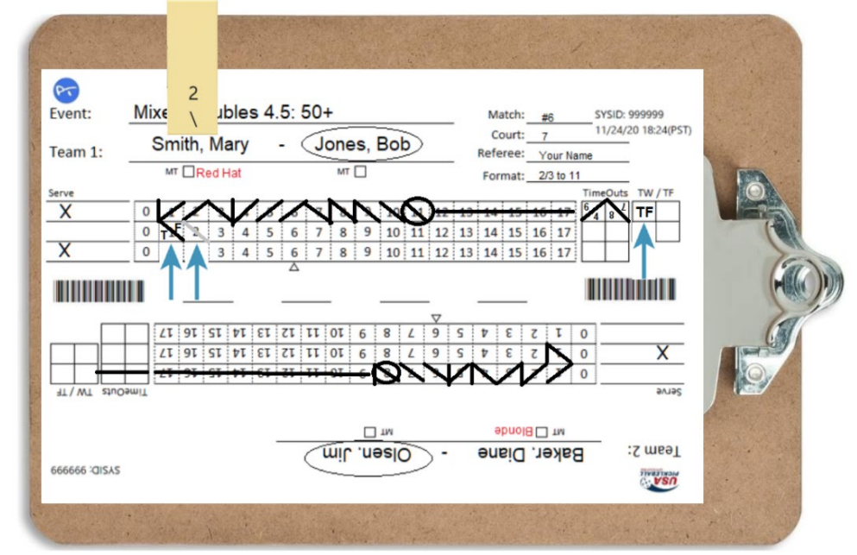
Recording a Technical Foul – Deducting a Point
When the offending team has at least one point – front of scoresheet

Slide 40
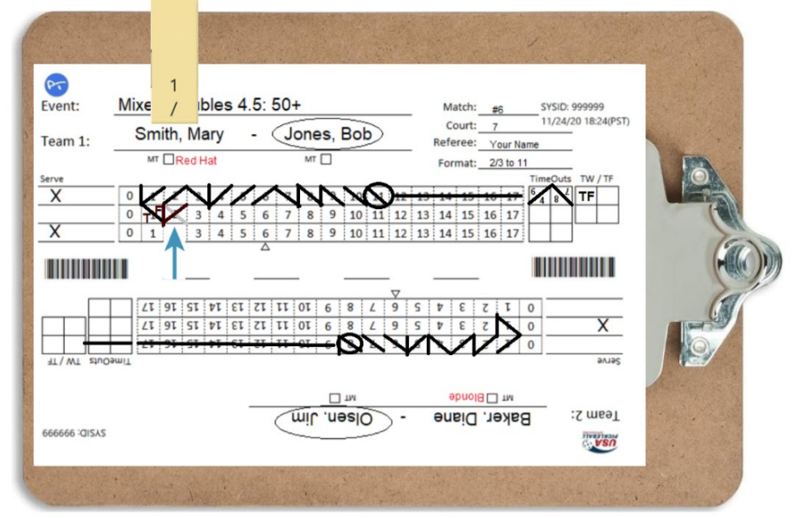
Recording a Point
After a Technical Foul Point Has Been Removed

Slide 41
Marking Technical Fouls (cont’d)
When a technical foul is issued and the offending team’s score is “0”:
Place a “TF” in the TW/TF box of the offending team
Write TF in the score box (non-offending team) to the right of the that team’s last score
If non-offending team is the receiving team, place a “|” to indicate side out after marking TF & adding a point

Slide 42
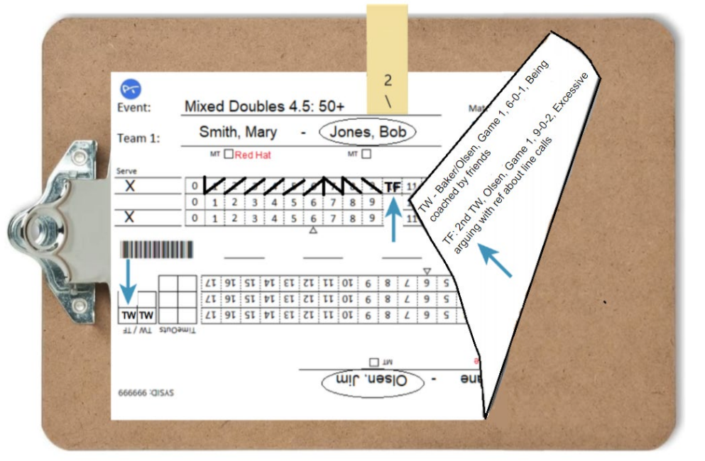
Recording a Technical Foul – Adding A Point
When the offending team has “0” Points

Slide 43
Technical Fouls (cont’d)
After Changing the Score Appropriately:
Clearly advise the impacted team that a point has been subtracted or added to their score
Announce “15 seconds”
At time, announce “Time in”
Call score & begin 10-second count

Slide 44
Technical Warnings and Technical Fouls
The scoresheet TW/TF boxes are not “columns”, but four boxes that can be used for TWs or TFs
Combinations of TW and TFs:
TW + TW = TF (1 + 1 = 2 Strikes)
TW + TF = Game Forfeit (1 + 2 = 3 Strikes)
TF + TW = Game Forfeit (2 + 1 = 3 Strikes)
TF + TF = Match Forfeit (2 + 2 = 4 Strikes)

Slide 45
Technical Warnings and Technical Fouls
13.G.3.c. If a referee issues a technical foul, one point shall be removed from the score of the offending team unless their score is zero, in which case a point shall be added to the score of the opposing side. After the point is removed or awarded, the player or team losing or awarded the point must move on their own to the correct position(s) that reflects their score (without prompting by the referee)
13.G.3.d. A called technical warning or technical foul shall have no effect on server change or side out.

Slide 46

Break/Questions

Slide 47
Game Forfeits
Declare a Game Forfeit If:
Player/Team receives a technical foul after receiving a technical warning for any reason
Player/Team receives a technical warning after receiving a technical foul for any reason
Player is not ready to play within 10 minutes of when match is announced
When TW & TF strikes = 3
(TW (1) + TF (2) = GF (3) or TW (1) + TW (1) + TW (1) = GF (3))

Slide 48
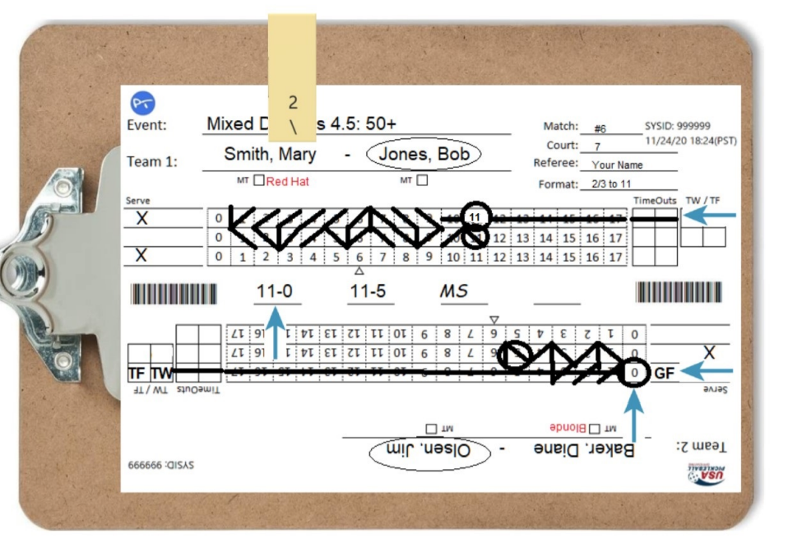
Recording a Game Forfeit
Forfeit of Game 1

Slide 49
Match Forfeits
Declare A Match Forfeit If:
During a match a player is discovered to be playing with a paddle that is not USA Pickleball approved
Player refuses to wear designated starting server identification
When TW & TF strikes = 4
(TW (1) + TF (2) = GF (3) + TW/TF (1) = MF (4))

Slide 50
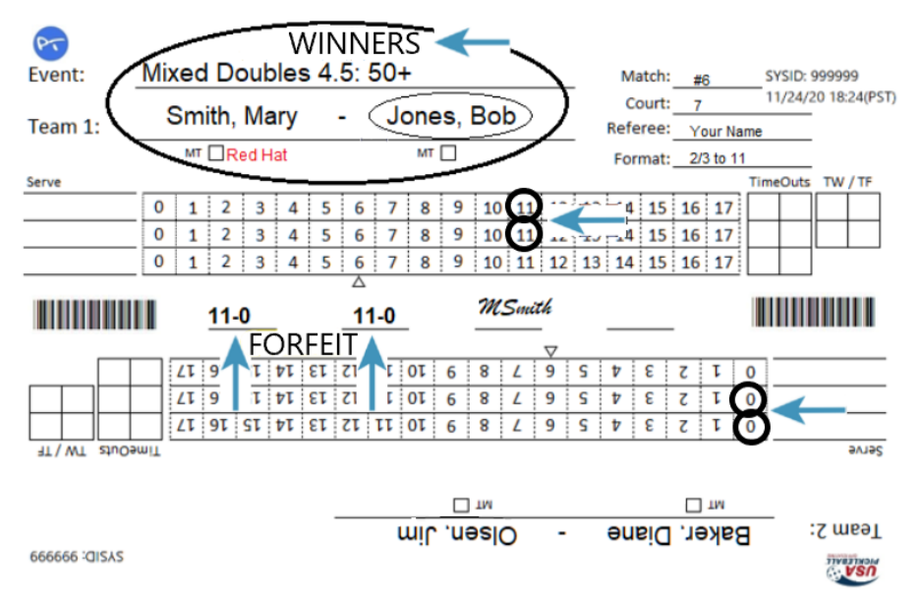
Recording a Match Forfeit

Slide 51
Match Retirement
A player or team may decide to retire from a match due to medical issues or other circumstances
Players retain all points scored when they retire from a match
Their opponent will be awarded the match
If the retiring team is withdrawing from all remaining matches, inform the players to report their withdrawal to the tournament desk. If the players are unable to inform the tournament desk, report their withdrawal when you turn in the scoresheet.

Slide 52
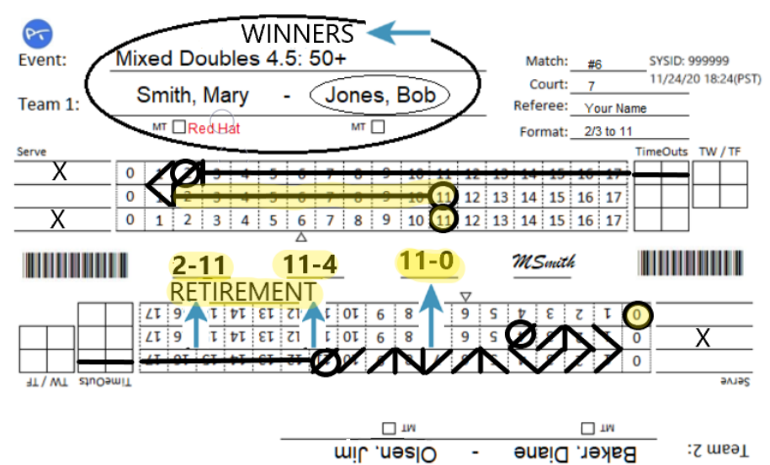
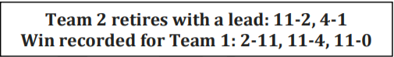
Recording a Match Retirement
(Players Retain All Points Scored if They Retire From a Match)

Slide 53
Quiz - Player Behavior and Remedies
Remain _____ ; maintain an ________ & _______________
Meet player(s) mid-court, ___________to discuss behavioral issues
A Progressive system of actions/penalties should be used to address inappropriate player conduct
Issue _________, _________, or __________ (Based On Severity) after the end of the rally
_____________ to create problems, _____________, as required.

Slide 54
Quiz Answer Key - Player Behavior and Remedies
Remain calm; maintain an open mind & benign demeanor
Meet player(s) mid-court, away from spectators to discuss behavioral issues
A Progressive system of actions/penalties should be used to address inappropriate player conduct
Issue verbal warning, technical warning or technical foul (Based On Severity) after the end of the rally
If player(s) continues to create problems, escalate discipline, as required.

Slide 55
Distractions
Declare a fault if a player creates a distraction
(e.g. waving paddle or arms, making loud noises or yelling, etc.)
when an opponent is about to strike the ball

Slide 56
Hearing Impaired Players
Accommodate requests to announce score extra loudly
Be sensitive & tolerant of a player asking to repeat score
Look toward impaired player when announcing score
Enunciate extra clearly
Use of an Arm Drop is recommended to signal the Call of the Score
Consider using extended finger(s) for score, if necessary

Slide 57
Keep Both Sides Equally Informed
(Transparency)
Conference at center court with all players
Include all players - avoid perception of one team gaining advantage or favoritism - everyone hears the same thing at the same time.
If discussion becomes intense, diffuse it:
Cut it off
Send all parties to neutral corners
Call Time In and announce Score
(see “Importance of Keeping an Accurate Scoresheet” video)
Notes:
To Ensure TRANSPARENCY

Slide 58

Importance of keeping an Accurate Scoresheet
(and keeping all players informed)
PPA Phoenix 2021 – Women’s Doubles Gold – Game 2
Irena Tereschenko/Jessie Irvine vs Leigh Waters/Anna Leigh Waters
Referees: Two referee format – Diahann Viada and Don Stanley
Video starting at 1:10:47 with Anna Leigh serving with score 5-9-1- Anna Leigh was NOT the correct server – but did ask the score and if she was the correct server.

Slide 59
Dual Referee Option – Goals & Responsibilities
(Officiating Handbook – Appendix C)
Increase accuracy of calls involving the NVZ and players crossing the plane of the net.
Second referee will stand on the opposite end of the net from the Lead Referee
Lead Referee responsibilities follow the traditional role including keeping the scoresheet

Slide 60
Dual Referee Option – Goals & Responsibilities
Second Referee Responsibilities
Calls:
- NVZ Faults
- Plane of net faults
- Service foot faults
- Short serves
- Player safety issues
Signals after the rally
- Out of position players
- Incorrect server or receiver
- Paddle thrown by a player
- Ball deliberately damaged by player

Slide 61
New Sanctioning Formats – No-Referee Sanctioning
USA Pickleball Recognizes:
- It may be difficult to have enough referees to effectively host
smaller tournaments with less than 300 players
N0-Referee Sanctioning is NOT available for:
- USA Pickleball National Championships (Indoor & Outdoor) -
- All National Championship Series Tournaments
- All USA Pickleball Diamond Regional Championships
- USA Pickleball Diamond Amateur Championships (Picotna)
- Any tournament with prize money Every bracket must be
refereed at least at the MMP level.
- Any tournament with greater than 300 registered players
- MMP tournaments that are run as round robin only, must have
a Head Referee at the venue.

Slide 62
New Sanctioning Formats – Mini-Singles
USA Pickleball Recognizes:
- The need to explore new opportunities for sanctioned play
- Mini-Singles is NOT meant to replace existing singles formats
- Mini-Singles is sometimes referred to as “skinny singles”
Mini-Singles (Skinny Singles)N0-Referee Sanctioning is NOT available for:
- Tournament Directors may offer both formats or just one format
- Scoring and service position is the same at traditional singles
- Only one of the two sides of each end of the court are “in play” for
a rally.
- An additional line must be provided that extends the centerline of
the court through the NVZ (color does NOT have to be the same
as other lines.

Slide 63
New Sanctioning Formats
USA Pickleball Website Resources
https://usapickleball.org/news/usa-pickleball-announces-two-new-sanctioning-formats/
(brief description of both new formats)
https://usapickleball.org/?s=Mini-Singles
(including a link to Mini-Singles Format Instructions)

Slide 64
Working
With
LINE JUDGES

Slide 65
Working With Line Judges
Line Judges:
Are part of the Officiating Team
Do more than call Lines
Are a referee’s second set of eyes & ears
Referee Is Responsible For Briefing Line Judges

Slide 66
Working With Line Judges
Line Judge Responsibilities:
Know the rules
Devoting FULL attention
Make “Out” calls on assigned line
Follow action on court
Provide opinion when asked by the referee
Do NOT speak with players or spectators
(Only Answer Referee Questions)

Slide 67
Working With Line Judges
Pre-Match Line Judge Briefing
Instruct Line Judges to:
Turn off cellphones
Remain attentive & avoid side discussions
Stand directly in line with your assigned line
Follow play & be prepared to offer opinion if asked by referee
Do NOT be influenced by spectator or player line calls
Remain at position until dismissed by referee

Slide 68
Working With Line Judges
Communicating Line Calls
- Immediately
- Confidently
- Loudly (on verbal calls for out balls and foot faults)
- Arm Signal (Hold for ~5 sec or ensure the referee sees it)
Passive Option
- TDs have a new “passive option”
- Players make their own line calls
- Line judges only make calls and signals when requested by the referee after an appeal by a player

Slide 69
Working With Line Judges
Ball Called “OUT”:
When making line calls, the criteria for line judges and referees (Rule 6.C), are different from those assigned to players (Rule 6.D.7)
Referee (6.C): ball contacting the playing surface completely outside of the court is “out”.
Players (6.D.7): questionable calls MUST be resolved in the favor of the opponent

Slide 70
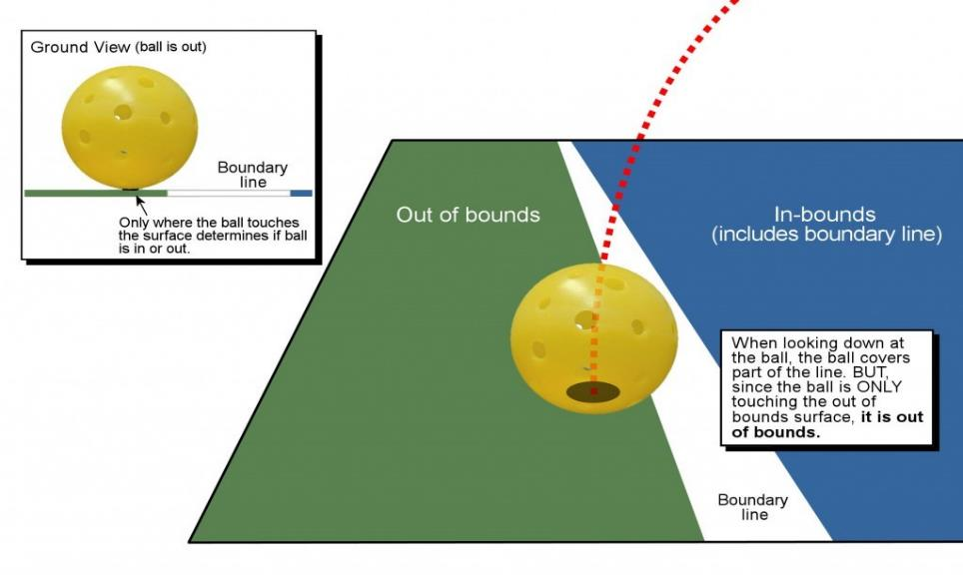
Working With Line Judges – Ball Called “OUT”
Line Judge/Referee Criteria for Making Line Calls (Rule 6.C)

Slide 71
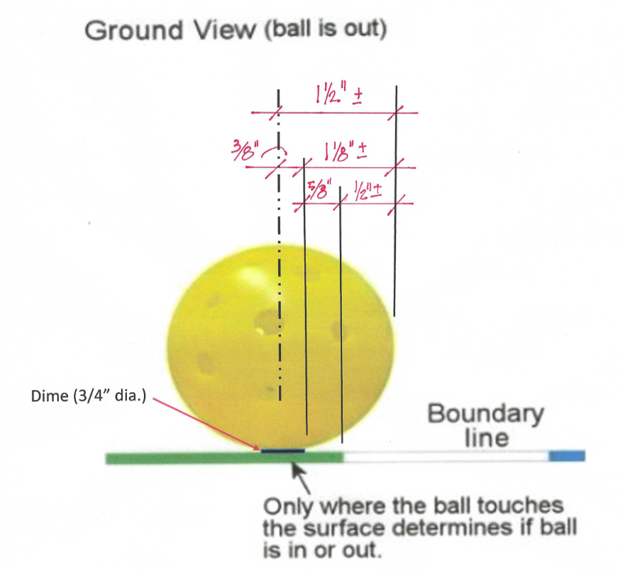
Working With Line Judges – Ball Called “OUT”
Line Judge/Referee Criteria for Making Line Calls (Rule 6.C)

Slide 72
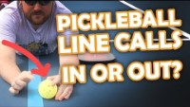
Working With Line Judges – Ball Called “OUT”
Barrett Kincheloe – Pickleball Kitchen
(Time stamp: from start then at stop 2:52)

Slide 73
Working With Line Judges
“perceptual mislocalization”
Inherent eye/brain delay that causes us to overshoot high speed
UC Davis Center for Mind & Brain Study – David Whitney (Associate Professor of Psychology)
A pickleball travels faster that humans’ eyes and brains can precisely track them. It bounces and this unpredictable change causes our visual system to make a slight error – the position where the ball bounces appears shifted in the direction of motion – “in” balls are often called “out” -
We tend to overshoot an object’s actual location and think it traveled slightly farther that it truly did
USTA
- focus your eyes on the portion of the line where the ball will land rather than
attempt to track the ball in flight – yes, “take your eye off the ball”!
- get your eyes to the spot well before the ball bounces

Slide 74
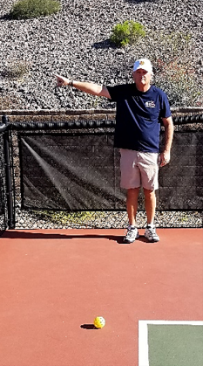
Working With Line Judges
Ball Called “OUT”:
Call “OUT” loudly & clearly to
stop lay
Arm should be raised in the
direction of the out ball (45°-90°)

Slide 75
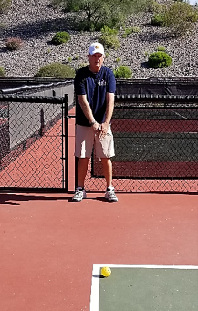
Working With Line Judges
Ball Cannot be Called “OUT”:
Visually show “IN” line call
signal - both arms extended
forward & downward, one and
on top of the other, palms down
NO verbal call

Slide 76
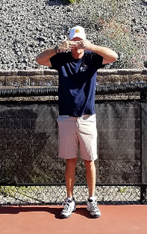
Working With Line Judges
Ball Blocked from View:
Cover both eyes with palms
of hands – Immediately
Referee can make call without
player appeal if the referee
clearly saw the ball “in”/“out”
Referee may ask other
line judges for their opinion

Slide 77
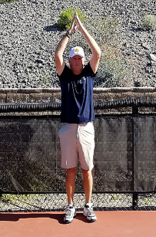
Working With Line Judges
Other Hand Signals – NEW:
Out of position, wrong
server/receiver – both hands,
palms together over your head
Signal AFTER the end of the rally

Slide 78
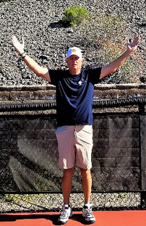
Working With Line Judges
Other Hand Signals:
Coaching from the sidelines –
arms extended at 45 degrees
to each side & palms open
Signal AFTER the end of the rally

Slide 79
Working With Line Judges
Instruct Line Judges to:
Call service foot faults and raise hand so referee can note that the line judge made the call (not a player)
Baseline judges: baseline
Sideline judges: extended sideline & center lines

Slide 80
Working With Line Judges
Instruct Line Judges to (cont'd):
Watch play on court – referee may ask for opinion
Double bounces
Balls touching players/clothing/etc.
Sideline line judges focus on ATPs and Ernes for player position/feet and “in” and “out” balls

Slide 81
Working With Line Judges
Instruct Line Judges In (cont'd):
Making Line Calls – Priority Responsibility
Impartial calls based on where ball lands
Balls that contact the playing surface outside of the court & Do NOT make contact with the Line are “OUT”
Unable to determine if a ball makes contact with the Line – ball is “IN”
Make all calls promptly – otherwise players will have doubt about your call

Slide 82
Working With Line Judges
Instruct Line Judges In (cont’d):
Making Line Calls:
Focus on your line of responsibility before the ball arrives
Call all balls contacting the playing surface outside of the court “OUT” regardless of how far out they hit
Do not make line call until ball touches the playing surface/court.

Slide 83
Working with Line Judges (cont'd)
Confirm Each Line Judge’s Readiness At:
Start of Match & Each Game
Before Resuming Play After:
Time-Outs
Any Extended Pause In Play
Overruling a Line Judge’s Call
The Referee Can Overrule a LJ’s OUT Call if 100% Certain
Players Can Overrule a LJ’s OUT Call
When it is to Their Disadvantage

Slide 84
Working with Line Judges (cont’d)\
Positioning Line Judge’s on the Court:
Basic 2/4/6 line judge configurations
Align just inside assigned boundary line – easier to see
space between ball and line
Standing vs sitting – standing preferred – ideally looking
over a fence vs through it.
End line judges opposite referee

Slide 85
Be Professional & Competent
The match is about the players and the game
NOT the referee
"The Most Successful Referee Is The One No
One Remembers After The Match"

Slide 86
Next Steps
This 3-day course is the “classroom” portion of the USA Pickleball Referee Training Program
The next step in the program is to attend the “on-court” portion with under the observation/coaching of a Registered Referee Trainer or Certified Referee (each USA Pickleball Region has a Referee Training Coordinator who can assist in identifying on-court trainers.
If you aren’t yet a USA Pickleball member, JOIN!
Practice, practice, practice!

Slide 87
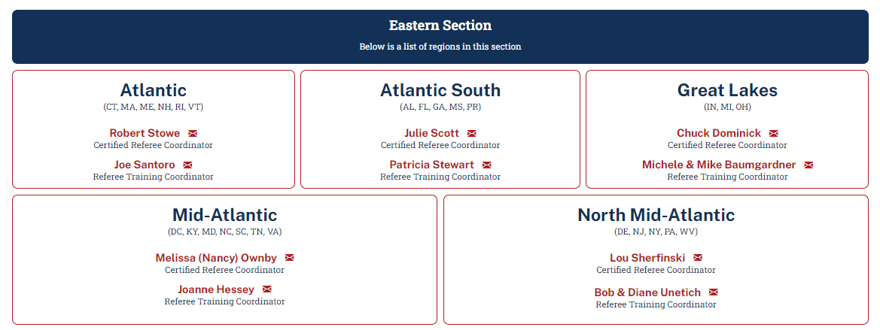
Regional Referee Training Coordinators
https://usapickleball.org/get-involved/pickleball-officiating-2/officiating-organization/

Slide 88
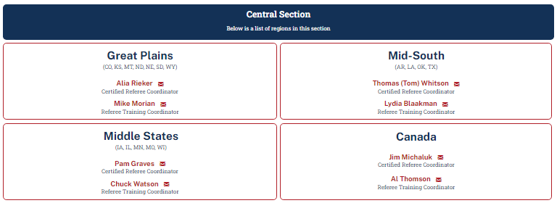
Regional Referee Training Coordinators
https://usapickleball.org/get-involved/pickleball-officiating-2/officiating-organization/

Slide 89
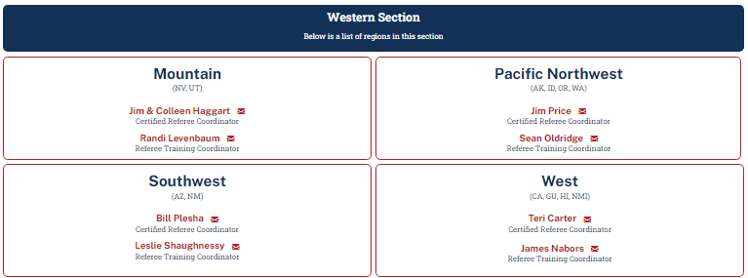
Regional Referee Training Coordinators
https://usapickleball.org/get-involved/pickleball-officiating-2/officiating-organization/

Slide 90
End of Day 3 - Questions

